Slide 1
AIR CANVA
A Minor project on presented by :
CSE, 4th yr student
1. Biswa Arpita Sethy (2101214078)
2. Debajani Sethy (2101214081)
3. Jyotirmayee Sethy (2101214096)
4. Soumyaranjan Dhal (2221214008)
Under the Guidance of:
Mr. Subhashis Mishra, Assistant professor, CSE

Slide 2
Content
Introduction
Problem Statement
Objective of Project
Literature Survey
Project Scope
Working Methodology
Tools and Platform Used
Output
Application
Advantages
Future Scope
Conclusion

Slide 3
Introduction
Air Canvas is an innovative drawing tool just by waving our hands.
So, in this project we are going to build an air canva using Python , OpenCV, Machine learning, mediapipe.
OpenCV is an open-source computer vision library for performing various advanced image processing tasks.
Unlike traditional input devices like keyboards and mice, which are precise but limited, modern methods include touchscreens and voice recognition.
Touchscreens, common in smartphones, can be less accurate and more expensive. Voice recognition offers hands-free input but lacks guaranteed accuracy in word recognition.
We’ll use color detection and segmentation techniques to achieve this objective.

Slide 4
Problem Statement
The overuse of smartphones, especially among children, diverts attention from education to social media and games, potentially causing depression, accidents, or mental health issues.
Paper wastage, through unnecessary writing and drawing, leads to deforestation.
Air Canvas, though not physically pocket-friendly, offers an alternative to traditional methods of drawing by using hand movement.
While Air Canvas has economic benefits, such as reducing costs and promoting sustainability, it requires devices and internet, which can limit its accessibility.

Slide 5
Objective of project
The Air Canvas project is a research initiative focused on developing a system that allows users to create digital artwork through hand movements in the air.
By using computer vision and machine learning algorithms, the system tracks hand movements and translates them into digital brushstrokes on a virtual canvas.
The project aims to provide a natural, intuitive user friendly, enabling users to explore various brushstrokes, colors, and techniques.
Additionally, it demonstrates the potential of computer vision and machine learning in creative applications, pushing the boundaries of human-computer interaction and artistic exploration.

Slide 6
Literature Survey
The Air Canvas project is a technology that enables users to create digital art in the air, translating gestures into virtual drawings.
It uses computer vision and machine learning to track hand movements and convert them into digital strokes.
We’ll use color detection and image segmentation to achieve our goals.
Color detection is an image processing technique where we can detect any color in a given range of HSV color space.
Image segmentation is the process of labelling every pixel in an image, where each pixel shares the same certain characteristics.

Slide 7
Project Scope
The Air Canvas project aims to develop a technology allowing users to create digital art in the air, transforming gestures into digital strokes on a virtual canvas using computer vision and machine learning. The scope of computer vision, especially with OpenCV, is vast, including object detection in both commercial and governmental applications.
Functional Requirements
Non-functional Requirements
Technical Requirements
Display Screen: A display screen (e.g., monitor)is used to display the generated digital artwork.
Camera:A high-resolution Camera (e.g.,Microsoft Kinect or Intel RealSense )is used the user’s hand movements.
Virtual Canva :Display artwork in real-time on a virtual canvas.
Real-time performance with minimal latency.
Accurate color detection and image segmentation with high precision.
Easy-to-use interface for users without experience.
Scalable to handle various hand sizes, shapes, and lighting conditions.
Hardware includes a high-resolution camera, a computer or mobile device, and a display.
Software utilizes OpenCV, Machine learning, Mediapipe and runs on Windows or macOS.
Beyond digital art, OpenCV is also used in areas like autonomous driving (ADAS) for traffic sign detection and medical imaging for tasks like microorganism detection.

Slide 8
Working Methodology
The Air Canvas system enables users to draw digitally by waving a finger equipped with a colorful tip, without using keypads, styluses, or gloves.
It uses a camera to capture hand movements and displays the artwork on a screen.
The system comprises hardware like a high-resolution camera and a display screen, alongside software components.
These include a hand-tracking module to detect movements, a gesture recognition module to interpret gestures, and a digital stroke generation module to create digital strokes based on gestures.
The virtual canvas displays the output, while the user interface provides options like color selection and brush size adjustment.

Slide 9
Tools and Platform Used
Hardware Requirement:
1. Camera: Optical instrument for capturing images, either still or moving (video). Derived from “Camera Obscura,” a precursor to the modern camera. Works similarly to the human eye, evolving from early photographic techniques.
2. Screen: Displays camera feed and drawing output. Essential for visualizing hand actions and performing drawing operations.
Software Requirement:
1. Python: High-level, general-purpose programming language created by Guido van Rossum in 1991.Emphasizes code readability and efficiency. Two major versions: Python 2 and Python 3, both differing significantly.
2. MediaPipe: Google framework for hand tracking and gesture recognition. Provides real-time, high-fidelity hand and finger tracking. Scalable to multiple hands, used in AR, sign language comprehension, and gesture control.
3. OpenCV: Library for image recognition and processing. Used for hand tracking, object detection, and drawing. Enables real-time computer vision applications in Python.
4. NumPy: N-dimensional array object (ndarray) for handling collections of items. Arrays are indexed and managed as memory blocks, essential for numerical computing.

Slide 10
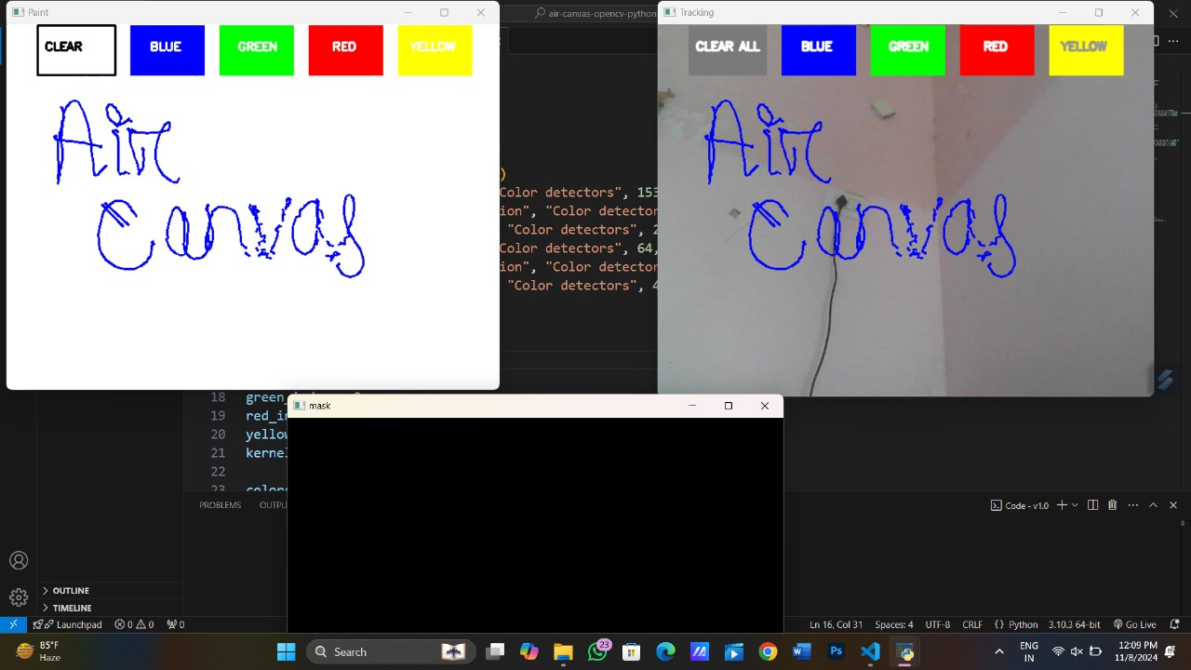
Output

Slide 11
Application
Air Canva is a versatile online design platform used for creating visual content in various fields.
In education, it helps teachers and students make presentations and infographics easily.
Businesses leverage it for marketing materials like social media posts and flyers using pre-designed templates.
Personal projects such as invitations and resumes can be customized with ease.
Additionally, it facilitates collaborative work by allowing teams to design in real-time. With its simple interface and broad toolset, Air Canva makes design accessible to both professionals and casual users.

Slide 12
Advantages
Air Canvas offers a unique way to present ideas by drawing in the air using a camera.
It enhances creativity by enabling artistic expression without physical materials, making it ideal for designers and artists.
It's also cost-effective, eliminating the need for expensive materials like paper and markers.
Enhances design creativity and saves time and efforts in identifying color accuracy.

Slide 13
Future Scope
By eliminating the need for traditional writing tools, it proposes an effective implementation method for screen-based teaching and design.
Computer vision, the science of enabling computers to interpret digital images, has seen significant advancements, often surpassing human capabilities in pattern recognition, especially in healthcare.
As the technology evolves, it promises simpler training processes and improved identification of images.
Future developments will integrate computer vision with other AI technologies, such as natural language generation, to create more engaging applications, including support for visually impaired individuals.
This field is also closely tied to the growth of virtual and augmented reality (VR and AR), with increasing market interest leading to the release of innovative technology products.

Slide 14
Conclusion
The color detection feature for air canva aims to enhance the design experience by automatically identifying and extracting colors from images.
The color detection feature for Air canva has the potential to revolutionize the design process.
Color Detection enables accurate color identification and extraction.
Color detection is the basic and important step for proceeding in computer vision.

Slide 15
THANK YOU

